Slide 1

Enabling the Responsible Use of Artificial Intelligence in the Government of Canada

Slide 2
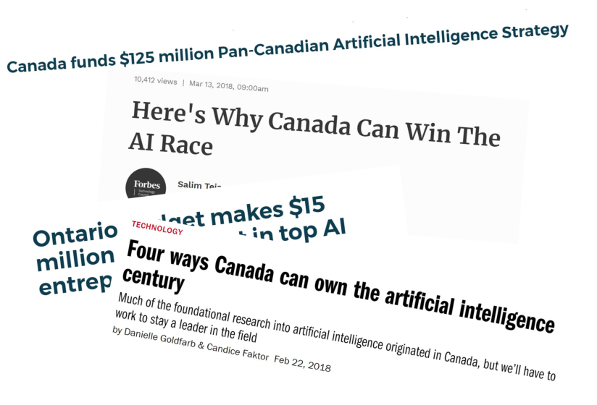
Canada and AI Innovation
Notes:
Canada is an early AI pioneer and has many research strengths in AI subfields such as deep learning and reinforcement learning
Global reputation as a human rights champion
Wold leading tech incubators and academic labs
Multicultural nation
Strong adoption of digital services
Open economy
Budget 2017 Pan Canadian AI Strategy
Budget 2018 Supercluster funding
Canada France Agreement
G7 / D9

Slide 3





An environment of low public trust for AI.
Acceptable
Access to government support programs such as employment insurance.
Which medical interventions are best for you and your family during an illness or after an accident.
The implementation of government policies such as who can immigrate to Canada.
Whether a person gets a job.
“AI & algorithms rather than people deciding on…”

Slide 4
Fast Regulation vs. Slow Regulation

Slide 5
AI in GC: Collaborative and Multi-Departmental
AI is a transformative technology that requires a collaborative enterprise approach, leveraging the strengths of many key departments. As departments are starting to work with AI, the following departments are providing support to the enterprise
Treasury Board Secretariat – Provides central leadership to GC on digital government, TB policy suite and oversight, Project review, Lead on open government/data, Employer of the Public Service
ISED – Coordinates external AI stakeholders, including the AI Advisory Council, Pan-Canadian AI Strategy, Supercluster Initiative, and Government’s of France and Canada Working Group
Canada School of Public Service – Offers training and enables experimentation
Justice Canada – Reviews and provides legal opinions related to the intersection of AI and the law
Statistics Canada – Performs enterprise data management, governance, and analysis
Public Services and Procurement Canada – Provides vehicles and support tools to enable the efficient, effective, and consistent procurement of AI across the government.
Employment and Social Development Canada – Leads social policy lead
Canada Digital Services – Supports business transformation through direct departmental support
Shared Services Canada – Provides large scale/centralized IT support
NRC – Supports departments and external stakeholders through education and funding opportunities

Slide 6
Starting to Define AI
AI is a term given to a variety of computer applications that automate human cognitive abilities such as perception, reasoning, pattern recognition, and problem solving.
Insights and Predictive Modelling
  Understanding patterns in data and using these patterns to predict future scenarios
  Can be used to discover insights in service clientele, understand what makes for successful employees, or better allocate financial resources
Machine Interactions
  Providing an automated service experience in natural language
  Can include chatbots that respond to simple service queries, or information provided over voice-based virtual assistants such as Amazon Alexa or Google Home
Cognitive Automation
  Automating the senses to derive insights from the world
  Can be used to recognize and understand handwriting in service applications or historical documents, to or recognize objects within images
Notes:
Insights and Predictive Modelling
Predictive analytics
Sentiment analysis
Machine Interactions
Chatbots
Home virtual agents
Cognitive Services
Image and video recognition and understanding
Process Automation
Automated decision-making support systems

Slide 7
Directive on Automated Decision-Making
  “The objective of this Directive is to ensure that Automated Decision Systems are deployed in a manner that reduces risks to Canadians and federal institutions, and leads to more efficient, accurate, consistent, and interpretable decisions made pursuant to Canadian law.”
  - Section 4 of the Directive on ADS
Transparency
  Promoting better understanding of system functionality
  Providing as much information to the public as possible
  Encouraging accountability (measuring of compliance and performance reporting)
Procedural Fairness
  Ensuring meaningful explanations
  Enabling examinations into the data used in making the determination
  Ensuring the ability to challenge the decision
Notes:
Governments are increasingly looking to utilize automated decision making systems to make, or assist in making administrative decisions.
Decision support systems are being piloted right now in some departments (e.g. IRCC, TC, PCH) and, if successful, could lead to a growing popularity of these systems.
On the spectrum of risk, Automated Decision Making has been identified as higher risk and should be addressed first.
Important that guidance is provided to departments to ensure that they take steps to reduce their risk, or the benefits of these systems can be lost
The aim of the proposed Standard is to provide guidance, help institutions better understand and mitigate the risks associated with automated decision making systems and to provide the appropriate governance, oversight and reporting/audit requirements that best match the type of application being designed.

Slide 8
Scope and Application
  Scope
  Systems that provide external services as defined in the Policy on Service.
  Any system, tool, or statistical models used to recommend or make an administrative decision about a client.
  Any system in production, excluding systems operating in test environments.
  Does not apply to any national security system.
  Coming into Force
  Takes effect on April 1, 2019, with compliance required by no later than April 1, 2020.
  Will have an automated review process planned every 6 months after the date it comes into effect.

Slide 9
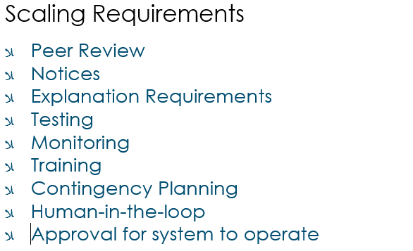
Algorithmic Impact Assessment
@CorriveauNoel

Slide 10
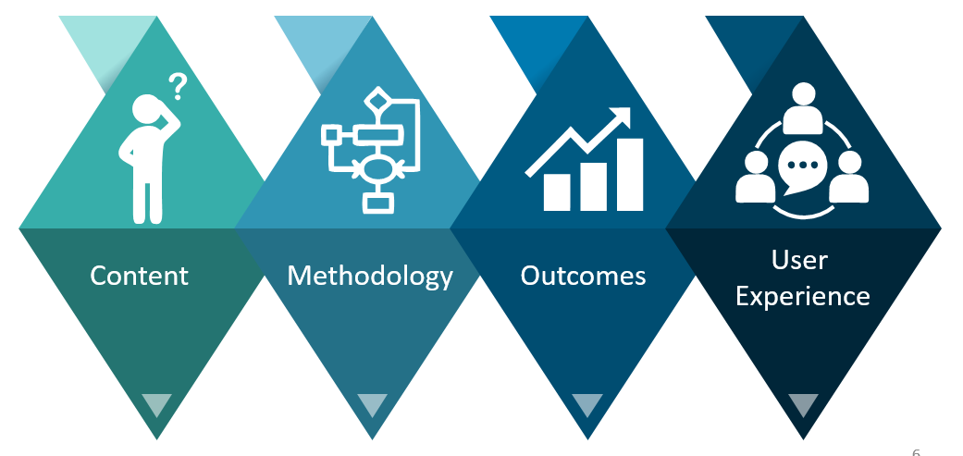
Algorithmic Impact Assessment
  Raw Risk Score : Assessing Impact
  Mitigation Score: Assessing Mitigation Measures
  Establishing Requirements
  Making the Results Public

Slide 11
Algorithmic Impact Assessment
https://canada-ca.github.io/aia-eia-js/

Slide 12
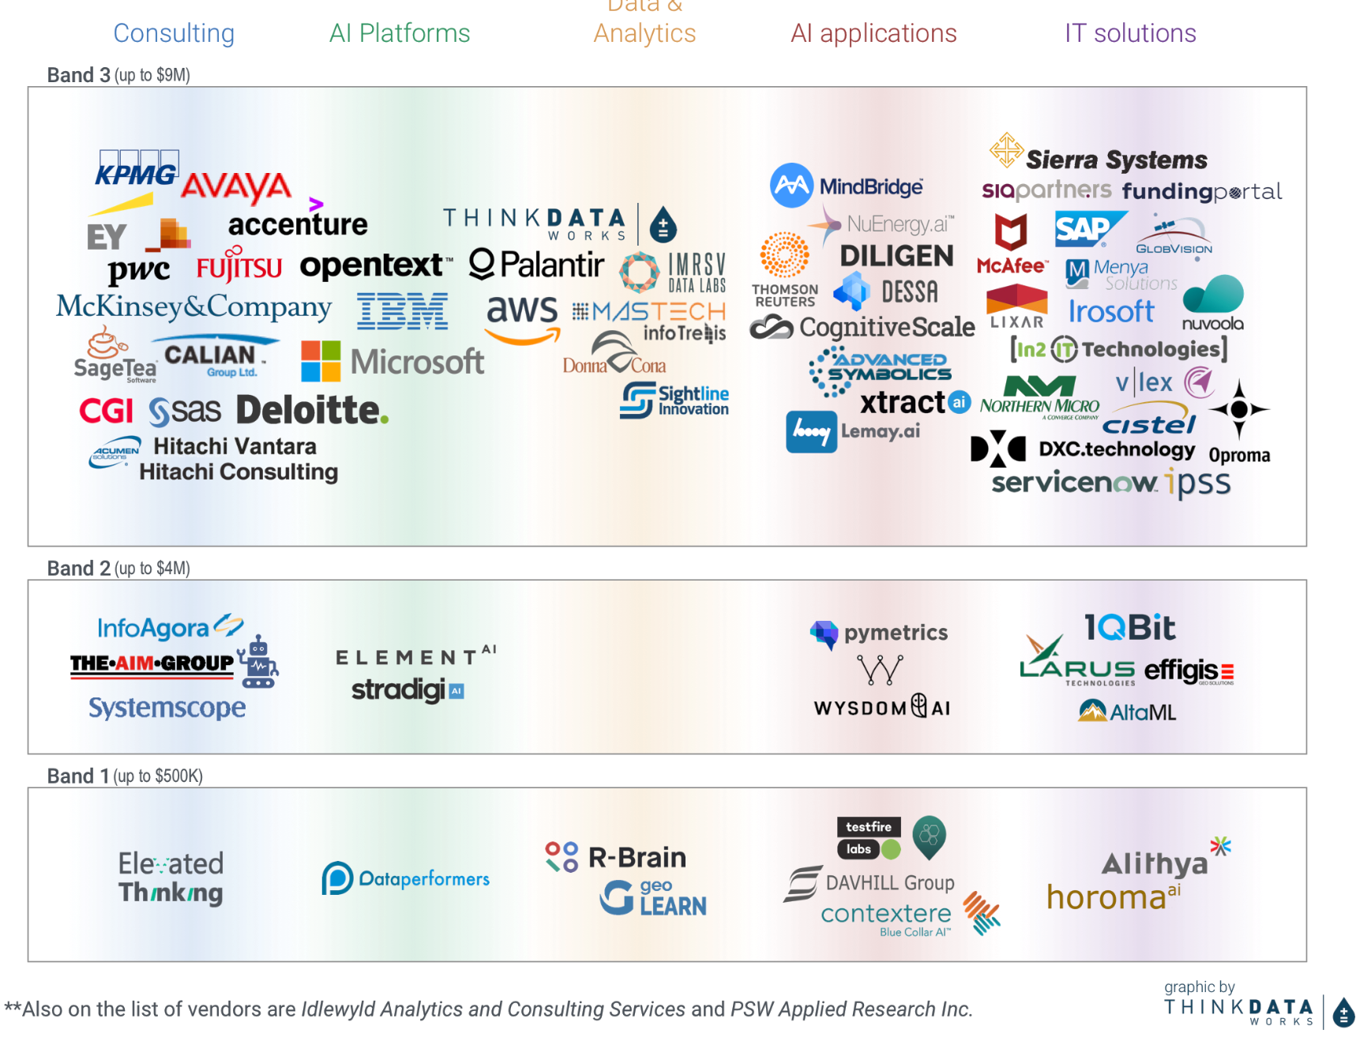
GC AI Procurement Strategy -
Data &

Slide 13
THANK YOU

